Slide 1
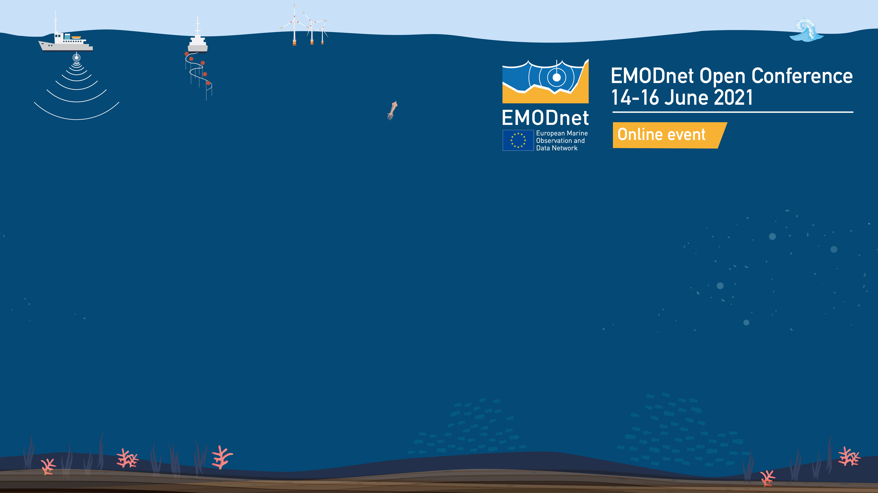
Session 1
EMODnet Data Ingestion
Sissy Iona,
Dick M.A. Schaap,
Project consortium
HCMR (GR), sissy@hnodc.hcmr.gr
MARIS (NL), dick@maris.nl

Slide 2


Overall Objectives
To identify, encourage and support data holders (from public and private sectors) to share their data with EMODnet and to become partner in the EU data management infrastructures for data exchanges.
To operate and maintain an extra EMODnet portal with services to facilitate data holders submitting marine data sets for publishing, further processing and safekeeping by expert data centres, and subsequent distribution through EMODnet thematic portals as open data.
To target data providers that are not yet routinely submitting data sets to national data centres and who are not yet familiar with the marine community data management practices and standards.

Slide 3
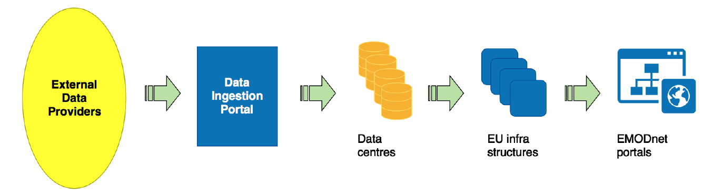
Principle data flow
Use and collaboration with existing European marine data management infrastructures and pathways feeding into EMODnet data portals.
(SeaDataNet, EurOBIS, ICES, EGDI, COGEA)
Workflow from submission to elaborating and processing for publishing in EMODnet

Slide 4
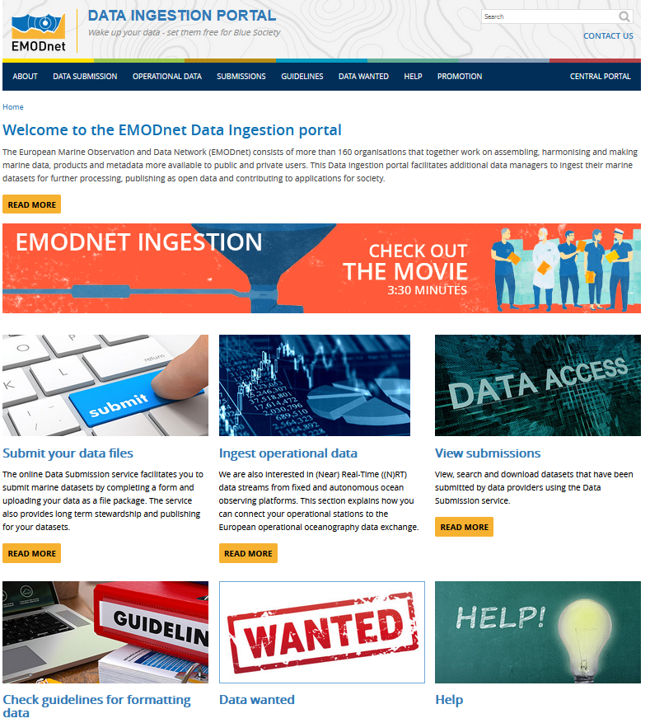
The EMODnet Ingestion Portal
and its services (since Feb. 2017)
www.emodnet-ingestion.eu
Data Submission Service (the core service)
(with integrated services such as the on-line submission form, user management service, tracking service)
Discovery and Access service
(operating on the ingested and completed data submissions)
Service for integrating operational data
(working together with EMODnet Physics)
Data Wanted service
Help Desk
Guidelines

Slide 5
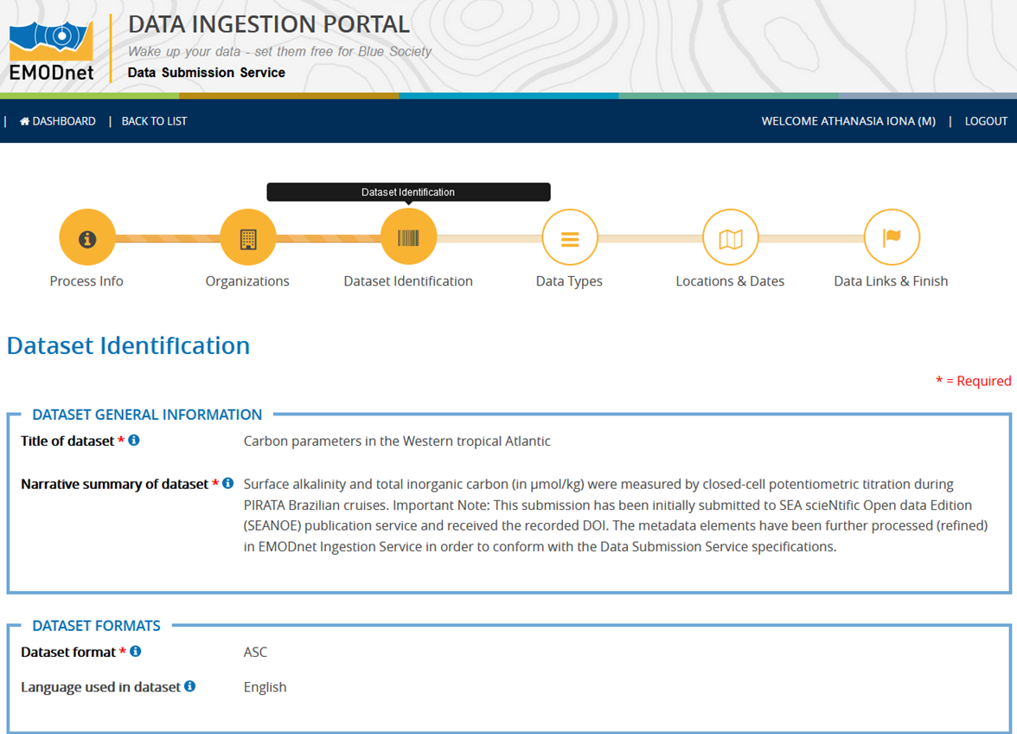
On-line submission form
Based on ISO 19115-2 standard
INSPIRE compliant
Five conceptually similar metadata groups with standardized or free text metadata fields

Slide 6
Data Submission process overview
Distinction between 2 phases in the life cycle of a data submission:
  Phase I: from data submission to publishing ‘as is’.
  Phase II: further elaboration and integration (of subsets) in national, European and EMODnet thematic portals.
Step 1: Data submitter completes a number of key fields of the submission form and uploads a zip file with the datasets and related documentation.
Step 2: Data Centre is assigned who reviews and completes the submission form for publishing ‘as is’ in Summary Service.
Step 3: Data Centre elaborates, where possible, the data sets, resulting in availability in standard formats in EMODnet thematic portals.

Slide 7
Involving all EMODnet thematic networks in the Ingestion pathways –
Cross Thematic Interactions
Ingestion Portal
Bathymetry
Biology
Seabed Habitats
Human Activities
Chemistry
Geology
Physics
Coordinators of all EMODnet Thematics are involved in EMODnet Ingestion partnership for ensuring the connections with their thematic networks for processing incoming data submissions.
SeaDataNet network of NODCs involved
EMODnet Ingestion network currently has 50 Data Centres covering all thematics.

Slide 8
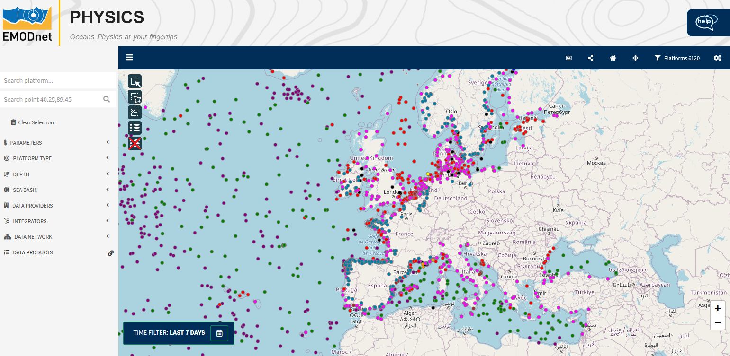
Joint cooperation with EMODnet Physics for ingestion of operational data
map.emodnet-physics.eu
Identifying, convincing and supporting operators of oceanography observation platforms and networks to connect their NRT data streams to the EU operational Oceanography data exchange, managed by Copernicus CMEMS INSTAC, EuroGOOS, and SeaDataNet (for archived data).
  Multiple platforms (>300) are now connected (HFR sites, river stations, T-MEDNET and SailDrone, wave buoys, Fish vessel data) with thousands of data sets.
Promoting and supporting uptake of Sensor Web Enablement (SWE) standards and services by operators of oceanography observation platforms and networks for streamlining and making their data flows more FAIR with richer metadata.
  >1500 sensors connected to the SWE demo
RT viewing service
www.emodnet-physics.eu/RealTime

Slide 9
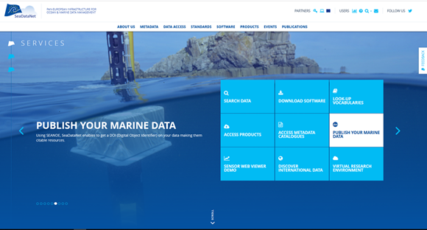
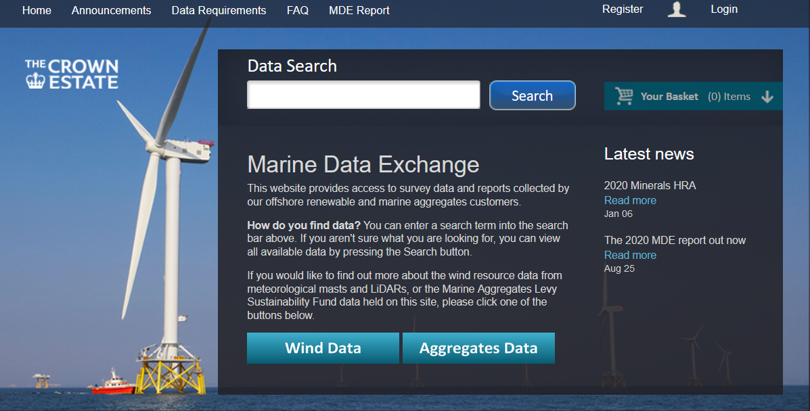
External collaborations - benefits
publish and get a DOI for your data !
Coupling with SeaDataNet/SEANOE data citing service:
  Dynamic exchange has been deployed.
  >100 Seanoe scientific data submissions are now in EMODnet.
Coupling with the Crown Estate Marine Data Exchange (MDE) is under development.
www.seadatanet.org/Software/SEANOE
www.marinedataexchange.co.uk/

Slide 10
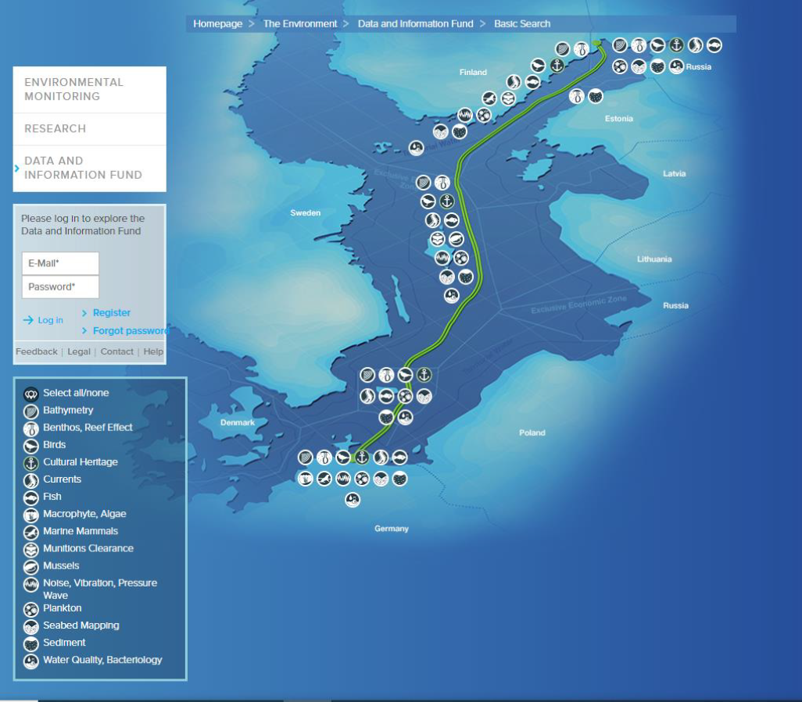
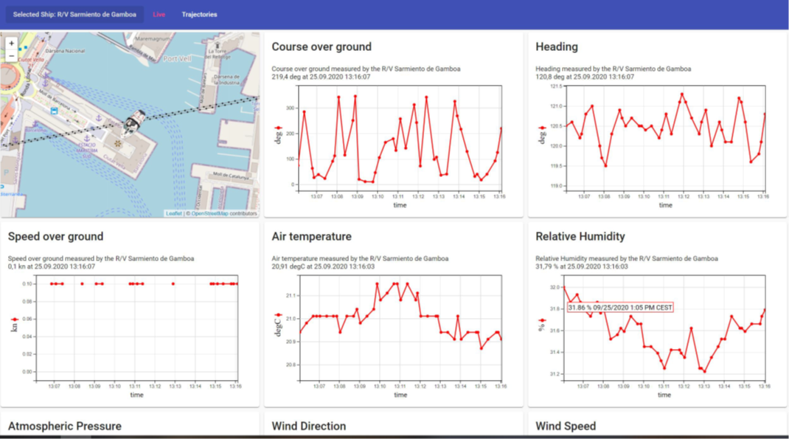
External collaborations - benefits
Agreement reached with Nord Stream 2 Pipeline AG about sharing marine environmental data as collected along the 1230 km long pipeline trajectory. First data collection for Sweden has been submitted and is being processed by SMHI.
Adoption of SWE standards in EuroFleets+ project for streamlining underway data flows from research vessels to hub at shore and wider distribution.
Role as ingestion service for Member States for submitting marine litter data sets

Slide 11
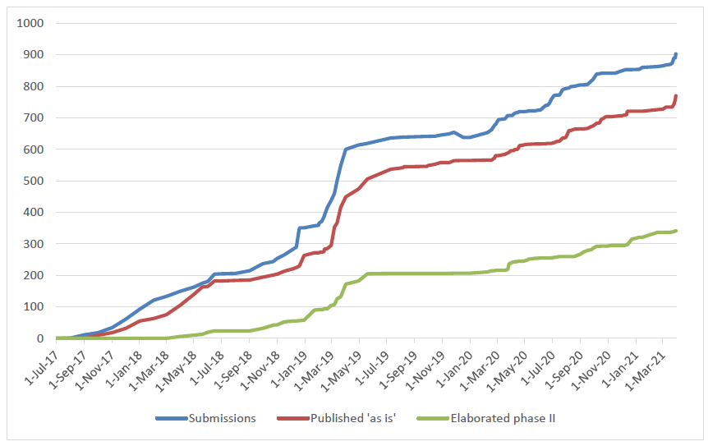
Overall Results
Submissions and processing in time: > 900 submissions in total, Phase I-II
as of end of March 2021

Slide 12
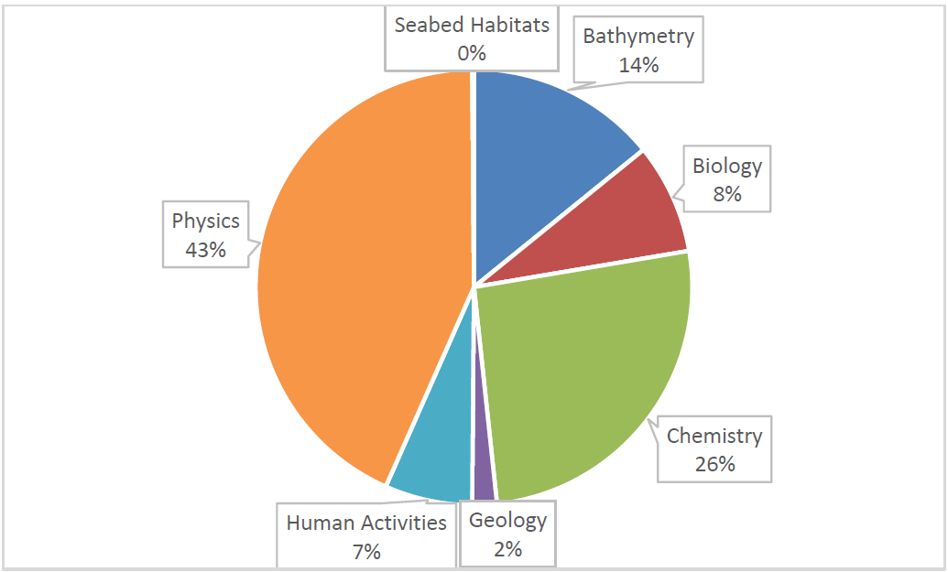
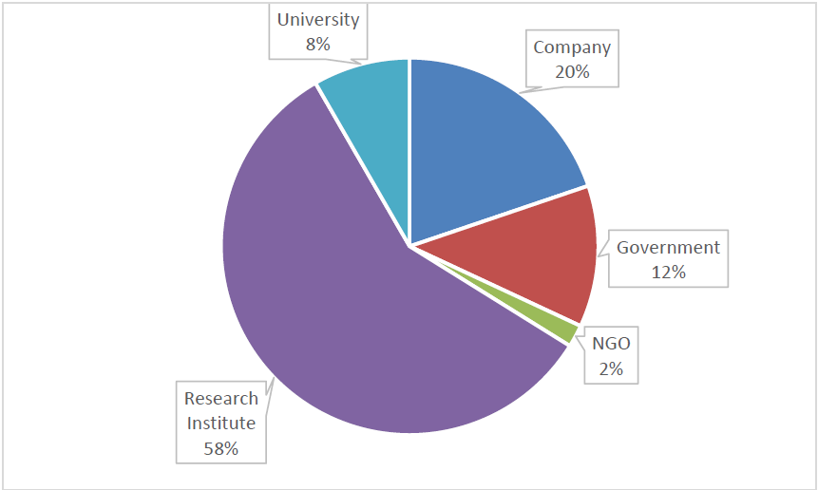
Overall Results
Published submissions (770) providing input to the EMODnet thematic products
by theme
by sector of data originators and holding centres
(133 Organizations in total)
as of end of March 2021

Slide 13
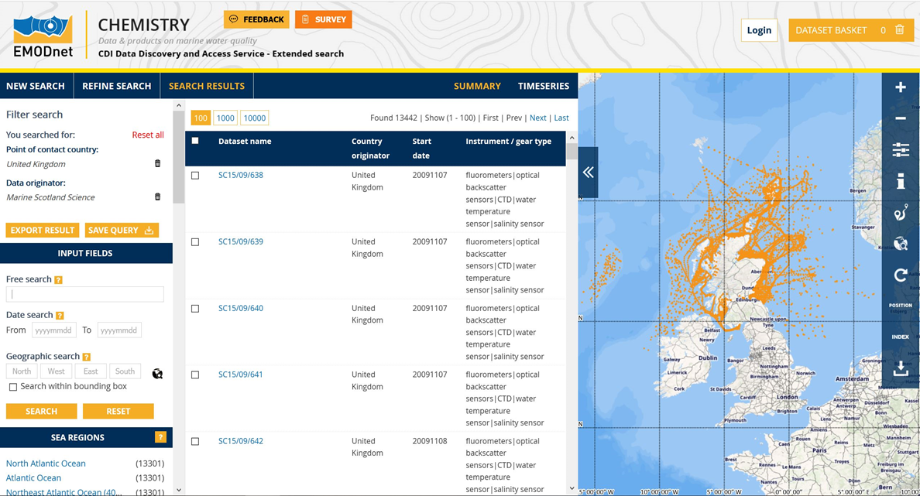
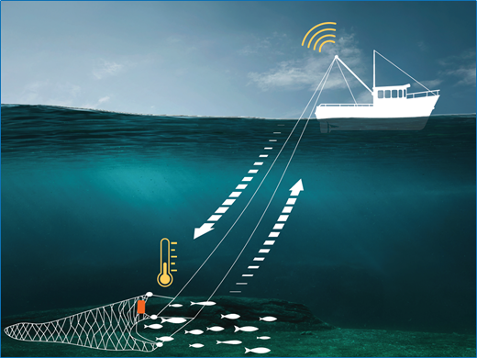

Successful use cases
Marine Scotland Science data:
21 cruises, 17081 stations already in
EMODnet Chemistry
Berring Data Collective:
Fishing data from in synergy with EMODnet Physics
Spirulina farms from JRC:
in synergy with EMODnet Human Activities

Slide 14
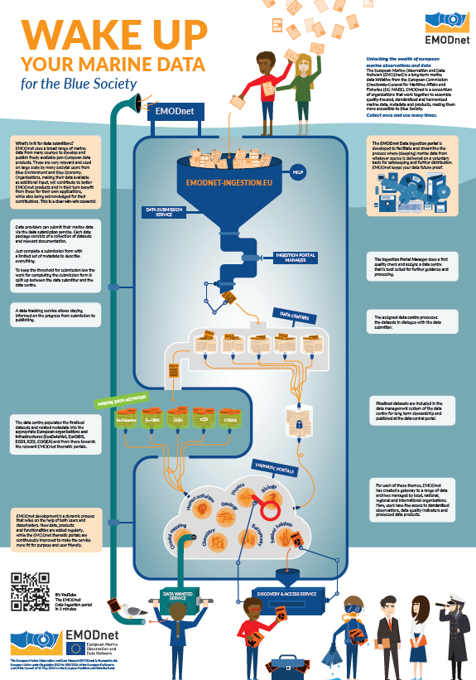

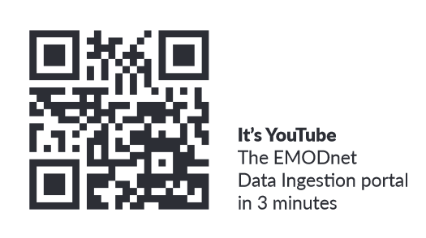
More about EMODnet Ingestion and what we can do for your data – Your Data Work It !
Check out our posters at the virtual exhibition room
Check out the video
on our EMODnet YouTube channel

