Slide 1
Progress EMODnet Ingestion
SC meeting, September 2017, Rome-Italy
Dick M.A. Schaap
MARIS, dick@maris.nl

Slide 2
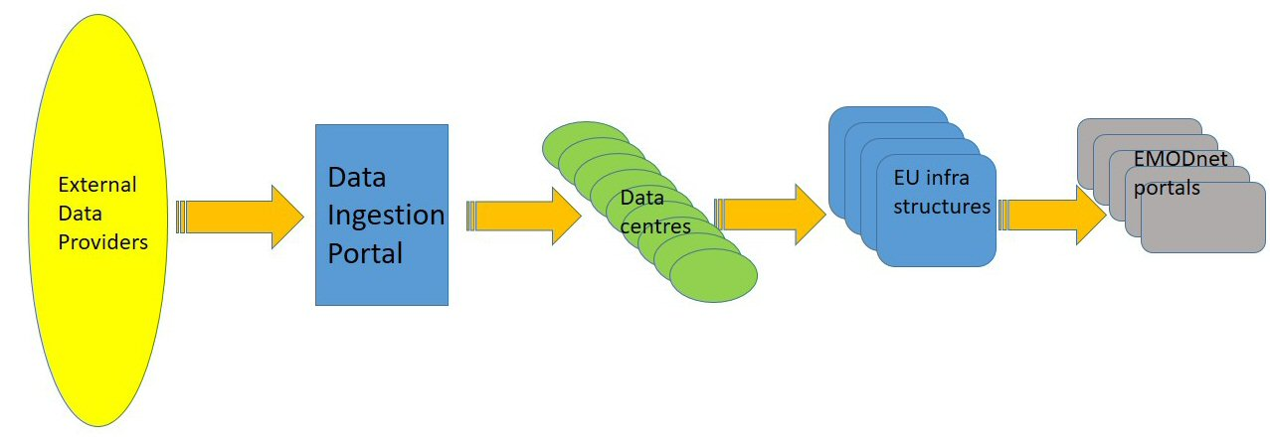
Aims
To develop and operate a new EMODnet portal with services that facilitate data holders from public and private sectors to submit marine data sets for publishing, further processing and safekeeping by data centres, and subsequent distribution through EMODnet thematic portals
Contract from 19 May 2016 – 19 May 2019

Slide 3
Development of portal and range of services
Ingestion portal, launched in February 2017, at www.emodnet-ingestion.eu:
General introduction and background information
Data Management Guidance and related documents
Data Submission service for Phase I
User Management service (Marine-ID)
Help desk service
Operational oceanography exchange guidance
News
Use cases
Promotional material
Extranet for project members

Slide 4
Set-up of Data Submission workflow
Distinction between 2 phases in the life cycle of a data submission:
Phase I: from data submission to publishing ‘as is’
Phase II: further elaboration and integration (of subsets) in national, European and EMODnet thematic portals.
Completion of the submission form (ISO19115 – INSPIRE compliant model) has been split in 2 parts:
Part 1 submission form: a number of key fields to be completed by the Data Submitter, including uploading of a zip file with the datasets and related documentation;
Part 2 submission form: review of the received datasets package and part I metadata, and completion of additional metadata by the assigned Data Centre.

Slide 5
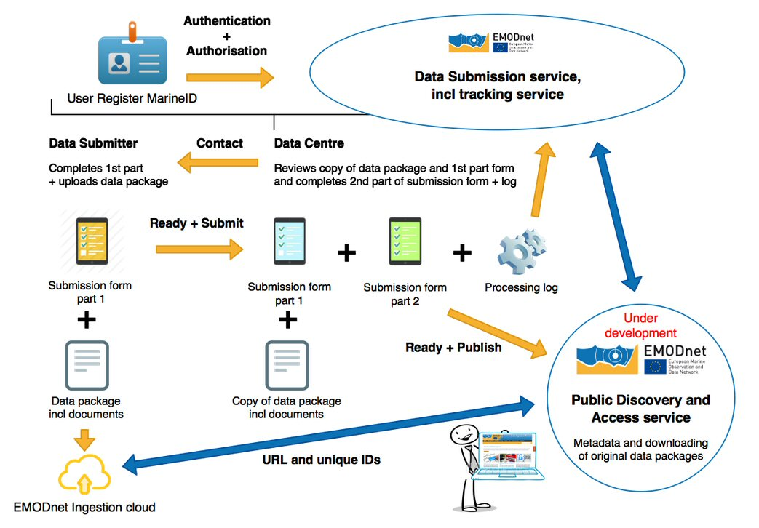
Data Submission Workflow
Phase I
workflow

Slide 6
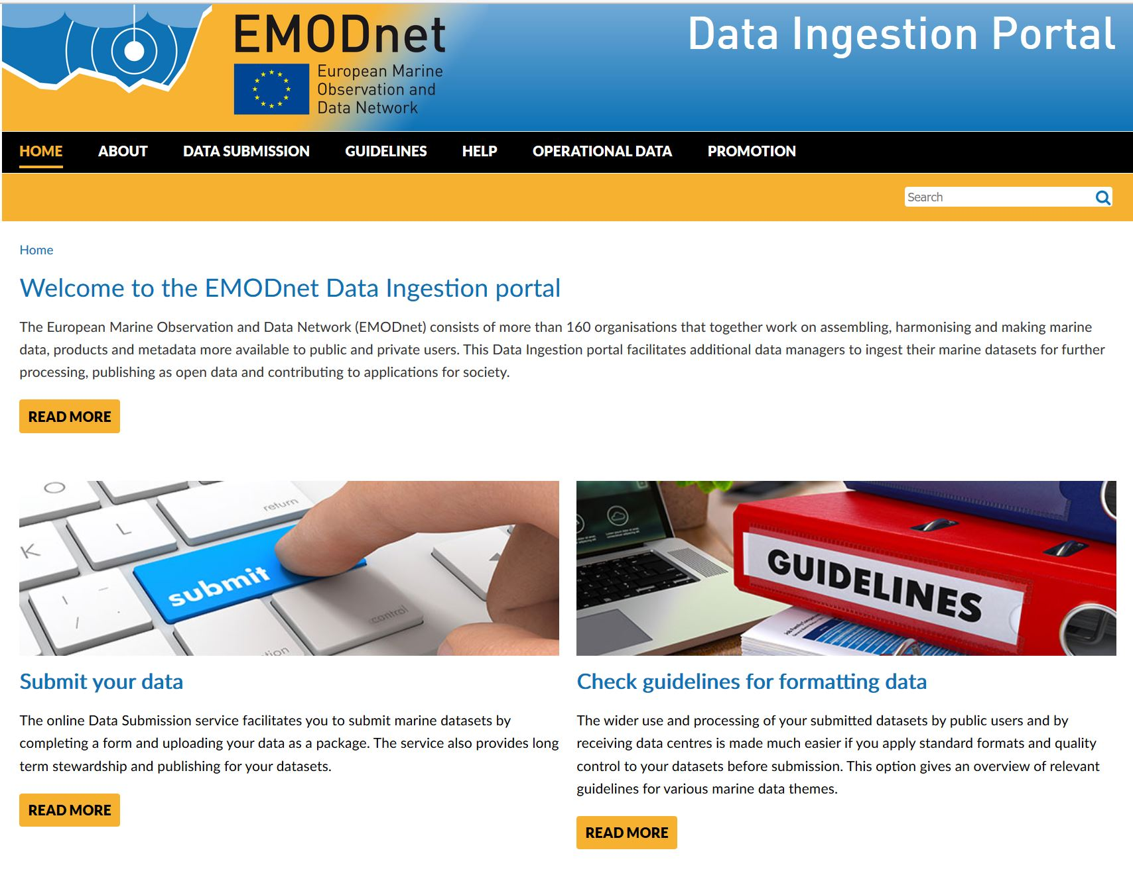
Operational Ingestion portal
Homepage
portal

Slide 7
Data Submission service
Landing page
Submission

Slide 8
Data Submission service
Dashboard
Submission

Slide 9
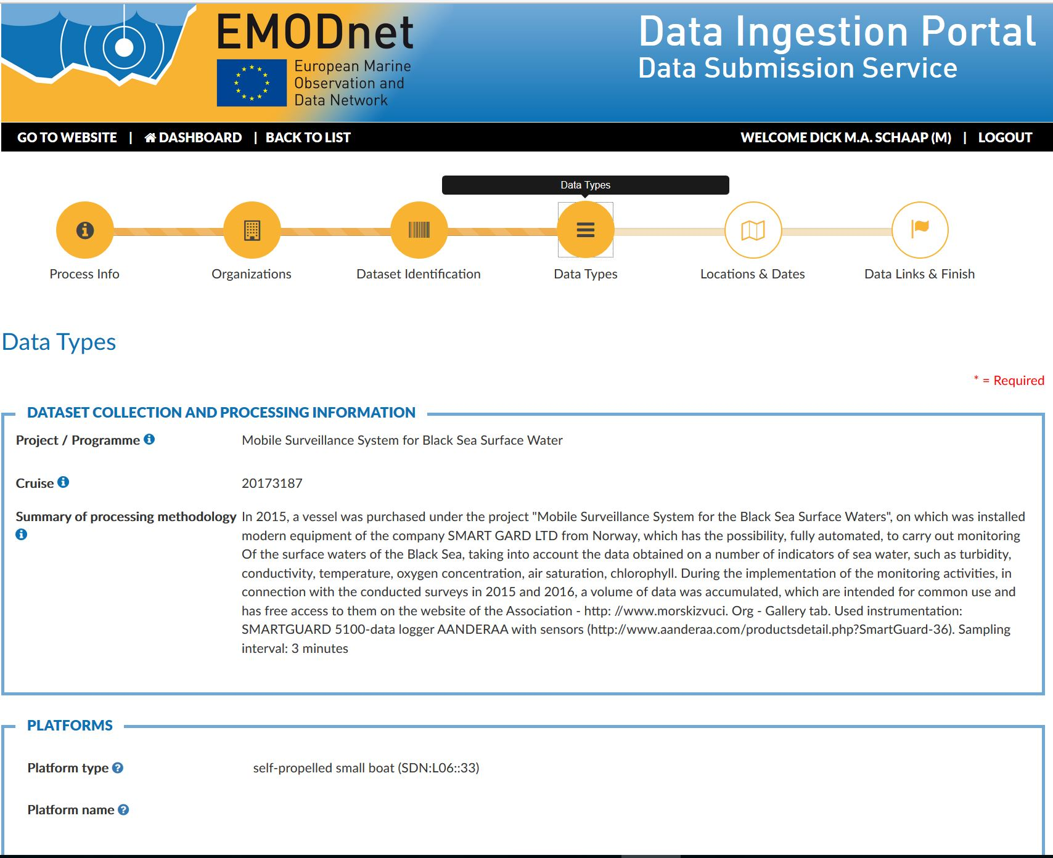
Data Submission service
Submission
form

Slide 10
Status of other planned services
Additional services underway for launching this month:
Summary Records service = Public discovery and access service
Data Wanted service
Submission service – extension for phase II
Submission service already includes:
Submission tracking by logs for DS, DC and M
Key indicators for DC and M
Also in parallel test submission and summary services have been set-up for tutorials and training of DCs

Slide 11
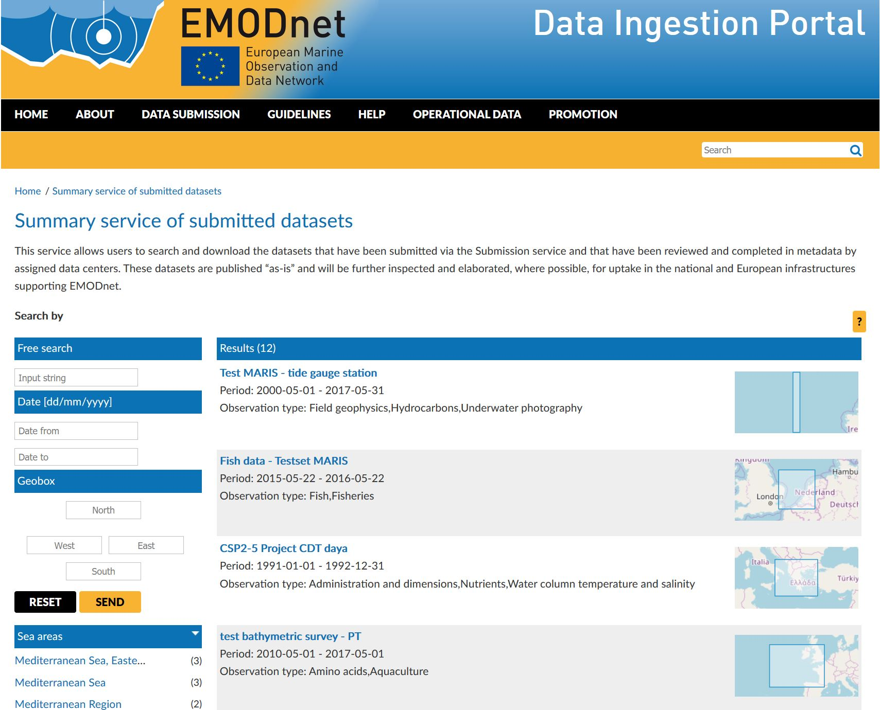
Summary Records service preview Preparatory activities in 1st year
Summary
Records
service

Slide 12
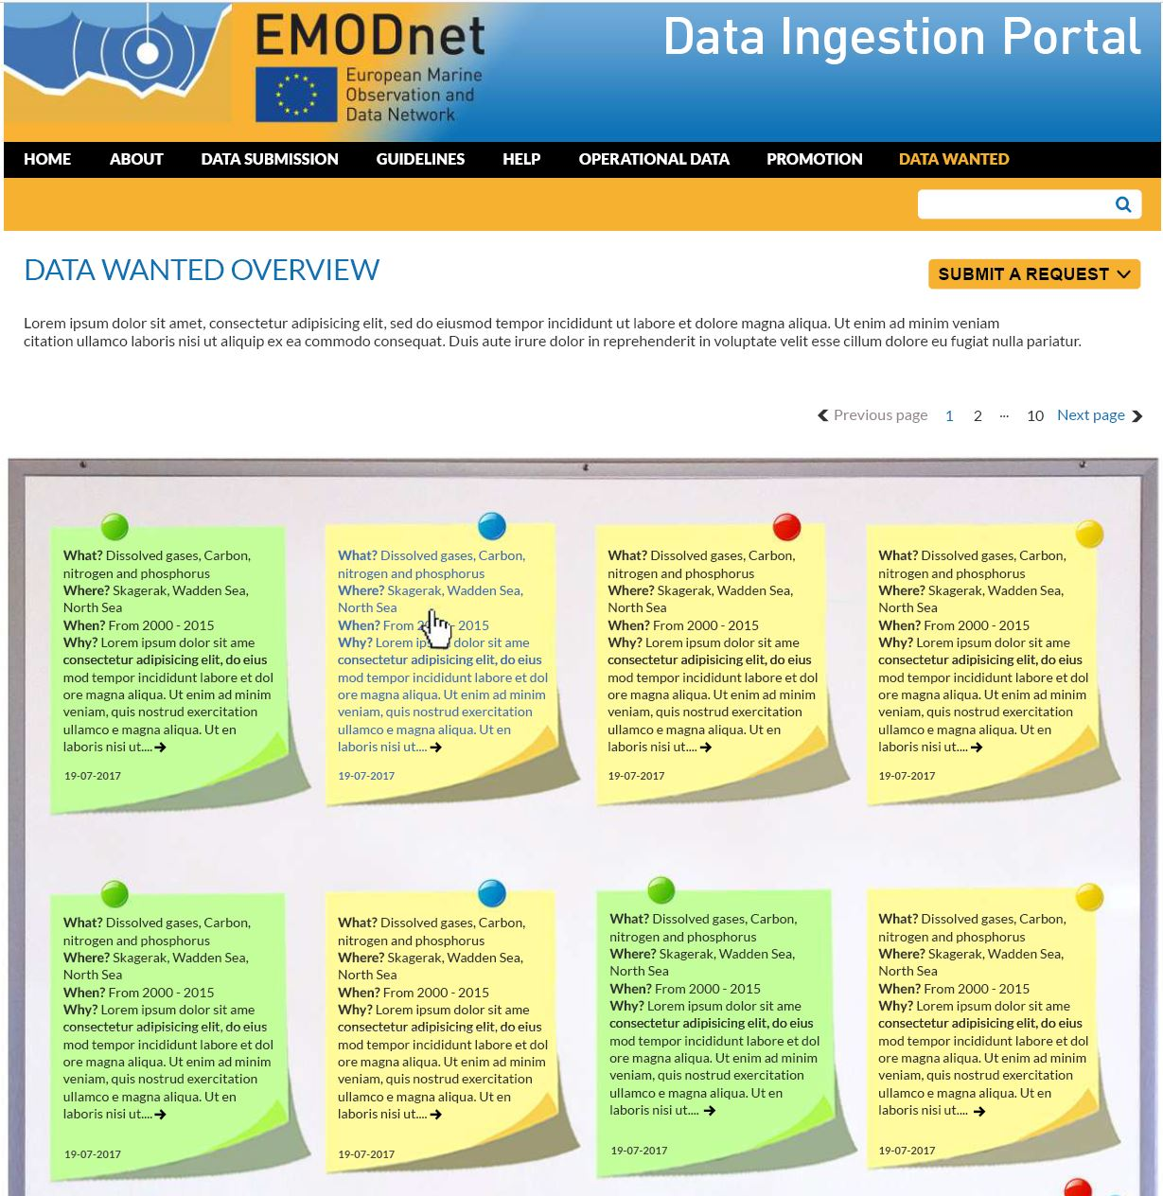
Data Wanted service preview activities in 1st year
Data Wanted
service

Slide 13
Pathways and tuning with thematic lots
Submitted metadata and data sets must be reviewed and completed by DCs for phase I and further elaborated for phase II to be fit for EMODnet uses => DCs from Ingestion consortium + thematic networks

Slide 14
Marketing and outreach activities
Identify potential data sources and data providers
Reach out to potential data providers
Motivate data providers to participate with their data submissions
Market and promote the Data Ingestion service and its function in the overall EMODnet scheme
DCs as EMODnet ambassadors
Promotional material: roll-out, bookmarks, poster, standard presentations, leaflets, video (October 2017)
Links at all EMODnet portals

Slide 15
Inventory of potentials and follow-up
A guideline and template was prepared for preparing an inventory per country of potential data providers, taking into account priority topics for thematic portals
Each DC has completed an inventory for its country.
Inventories were bundled and reviewed at 2nd Plenary Meeting. Resulting is an overall inventory, comprising 26 countries and 466 potential new data sources.
DCs are following up the shopping list towards identified data providers.
DCs are training themselves in using the Submission service and getting well acquainted with procedures and benefits

Slide 16
Status of submissions
At present > 30 submissions recorded in different stages of processing
Several from scientific activities; a few related to offshore industrial developments such as surveys for new pipelines and harbours
More efforts and submissions underway, also as part of the use cases with planning and impact monitoring for wind farms in the North Sea (Netherlands and UK sectors)
Circa 10 submissions completed for phase publishing ‘as is’
A few already nearly completed for phase 2 publishing as part of national, SeaDataNet and EMODnet portals.
Summary Records service will be launched soon at the portal to publish the completed submissions

Slide 17
Conclusions
1st year spent on building the portal and its range of services which are nearly all ready and operational
1st year also spent on:
establishing an organisation for the handling of incoming submissions as pathways
developing marketing approach, including guidance, education, and supporting promotion material
Compiling an inventory of potential data sources and providers
Now full action by all ingestion DCs for reaching out and gaining momentum
First results achieved and more coming
However it does not come easy as it takes quite some efforts to convince and to coach potential data providers to ‘pass the bridge’

Slide 18
Input needed
EMODnet Ingestion should be presented at several conferences and other events which are joined by consortium members and wider EMODnet community.
Can be by presentations – stand-alone or integrated in other thematic presentations - , posters and roll-out.
Ideas so far: EuroGOOS, AGU, GEBCO, EuroGeoSurveys, WOC
Other suggestions?

